Slide 1
Functions in python

Slide 2
What is a function?
The complexity of many algorithms comes from the flow of execution contained within its structures.
Many nested structures can create a flow of logic that is extremely
difficult for humans to understand
We resolve this complexity by subdividing our programs into multiple parts.
Each handling only a single responsibility.
These parts are called functions.

Slide 3
You can think of a function as a mini-program.
It gets some starting values
It provides an answer at the end.
Functions exist independently of your main script program.
They only get executed when they are invoked by your main program.
In essence, your main script program is the program.
It just sometimes causes other smaller programs to run.

Slide 4
Function…….
So far, we’ve been writing all our code in one block. But writing code like this can be very impractical.
For example, suppose we had to check if our users were entering numbers instead of strings. We could set up an if statement and prompt them to enter information correctly.
However, we might need to do this lots of time. Instead of writing the same error checking code over and over again, we can set up something called a function.
This is a separate block that we can call into a action whenever we need it. Let’s see how functions work.

Slide 5
Advantage of Function
By using functions, we can avoid rewriting same logic/code again and again in program.
We can call python functions any number of times in a program and from any place in a program
We can track a large python program easily when it is divided into multiple functions.
Reusability is the main achievement of python functions.
However, Function calling is always overhead in a python program.

Slide 6
How to make a function in python?
To set up a function, you start with the keyword def.
This is needed for every function you are setting up(defining).
After space, you need to come up with a name for your function. (This can be just about anything you want, but the same rules to naming variables apply to functions).
After your function name, it needs a pair of round brackets.
The round brackets are used to pass values over to your function. But they can be empty, if your function doesn’t need anything passed to it.
To complete the function definition, you end it with a colon.

Slide 7
Example :
def error_message( ) :
The first line of your function shouldn't be indented, but all the lines insides of your function should be.
Add a simple print statement as the next line of your function. Make sure it is indented : def error_message( ) :
print(‘Something went wrong’)
Function don't do anything until you call them into action. You do that by typing the name of your function( no need for the def keyword). You add the round brackets after the name of your function. The colon is not needed at the end.

Slide 8
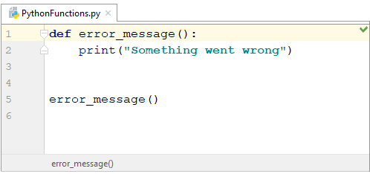
Add this line to your code :
error_message( )
Don’t type it immediately after the other two lines. By convention, two blank lines are added after setting up your function and the rest of your code. But here’s what it should look like now :

Slide 9
Run your code….
You should see “Something went wrong” printed to the output window.
So typing the name of your function, followed by its round brackets, is enough to call that function into action.
You may be wondering if your function can go after the call. Can you do this, for example ?
error_message( )
def error_message( ) :
Print(‘Something went wrong’)

Slide 10
The answers is, no, you can’t.
Python executes your lines of code from top to bottom. If you call your function first, it won’t know anything about a function that’s further down in your code, so it will give you an error.
Points to be remember:
Functions can be as long and as complicated as you like. But they tend to do just one job.
And a job might need to be done again and again in your code.
They ensure that you’re not typing the same code repeatedly.

Slide 11
Parameters in function:
The information into the function can be passed as the parameters. The parameters are specified in the parentheses.
We can give any number of parameters, but we have to separate them with a comma.
In our function, we say ‘we expect to be provided with some information before we can work’.
This is the information provided to our function by the outside world who will call our function.

Slide 12
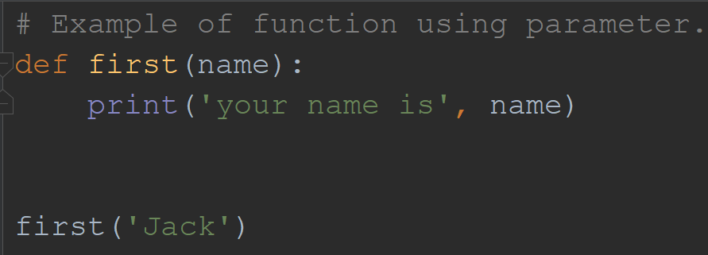
Consider the following example which contains a function that accepts a string as the parameter and prints it.

Slide 13
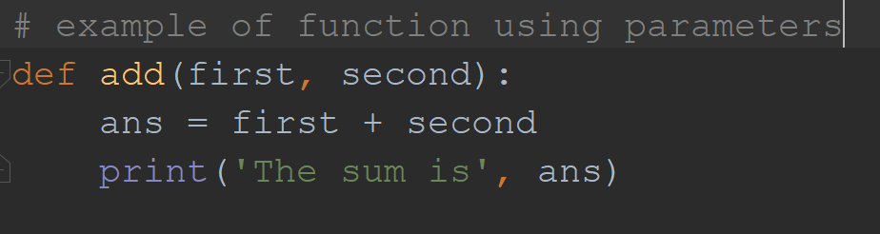
Let’s try another function which adds two numbers:
Just think what is necessary two add two numbers for the function- simple function need two number which will be added.
So these two numbers are parameter which will be asked by function.
Start to make function by def keyword and following with function name and colon.
The function name is an identifier which means it is the user defined word.

Slide 14
Calling the add function:
First know that function itself cannot be executed. It should be called by other to get executed.
To call the function just simply write function name and pass the value asked by it in the form of parameters.
<Function Name>( arguments)
Argument: is the value that is required to passed at the time of function calling.
Add(4, 6)
4 and 6
Arguments

Slide 15
Functions return values :
As well as handling values to your functions, function can also hand values back to the calling line. This is known as the return value.
What we’ll do is to have our function add up, and then return that answer to the line where we called the function into action.
In your add function from the previous slide, delete the print line. Now add this in its place :
return ans

Slide 16
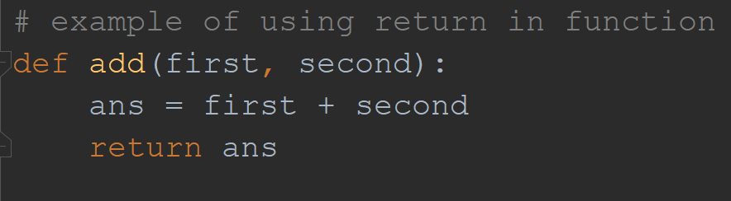
Then your code will look like this :

Slide 17
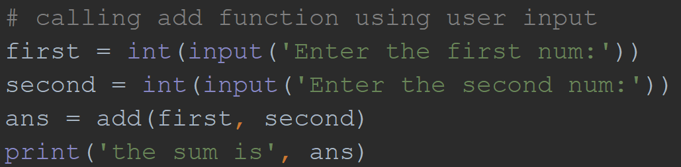
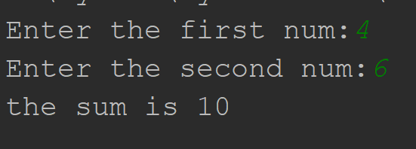
Taking user input for arguments for previous function:
Output

Slide 18
Remember :
To get something back from a function, you see the keyword return. After a space, you then type the value that you want out of your function.
Arguments vs Parameters
Both refer to the input of a function but it is important to remember the difference:
Arguments are the values we pass to the function in a particular function call
Parameters are variable names used in the function definition to refer to the arguments.

Slide 19
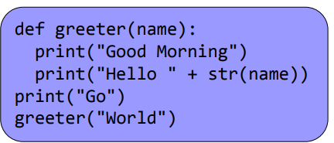
Quiz: What is printed in what order?

Slide 20
So why do we build functions?
Suppose you have a task you do multiple times Writing one functions saves time writing code and makes code easier to read.
Functions can also aid code readability if:
You give meaningful function names;
You document them properly.
Functions let you break up large complex problems into smaller easier ones. Can aid thinking by decomposing problem into tasks: known as Functional Decomposition.

Slide 21
Local variables :
Any variables created as part of a function definition are called local variables.
Parameters are local.
Local variables exist within the individual function call only.
Python destroys them at the end.
They cannot be used in the main script, or in other functions.
A function definition can use variables (and other functions) from the main script. It can not edit them though.

Slide 22
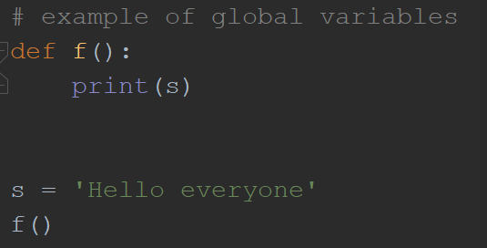
Global variables:
Global variables are the one that are defined and declared outside a function and we need to use them inside a function.
S is a global variable because it is defined outside the scope of f( ) function.

Slide 23
Namespaces :
Things can get confusing when there are variables with the same name which mean different things. Python works in namespaces: sets of variable assignments.
Each function has its own namespace;
There is the main namespace for the top level;
A function can only use a variable from the main namespace if there is not already a local variable with the same name.

Slide 24
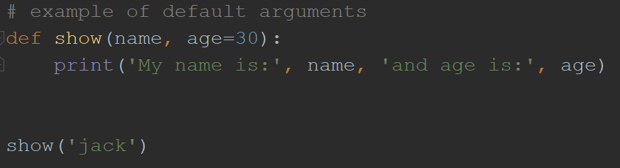
Functions Default Arguments :
Python allows us to initialize the arguments at the function definition. If the value of any of the argument is not provided at the time of function call, then that argument can be initialized with the value given in the definition even if the argument is not specified at the function call.
output

Slide 25
Triangle Example :
We finish by looking at some larger code.
It calculates the area of a triangle using Heron’s Formula (it is not important whether or not you know the mathematics of this).
Just understand that the formula needs to know the length of the 3 sides to work.
So we write one function to calculate side length and use it in a second function which does Heron’s Formula.

Slide 26
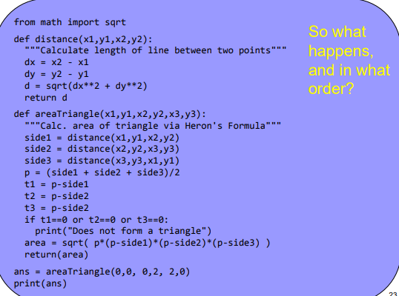
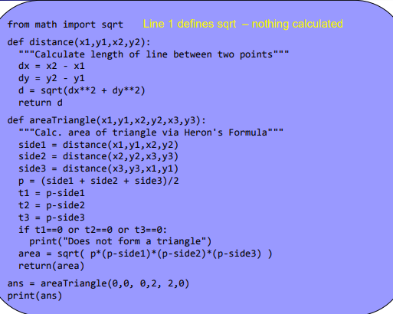

Slide 27
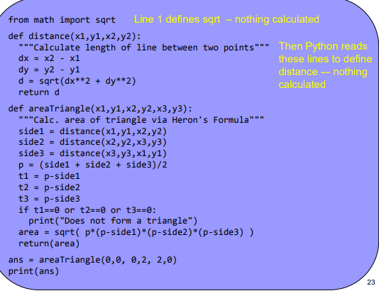
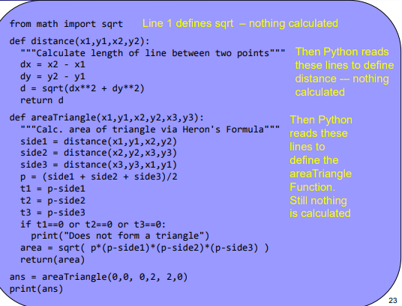

Slide 28
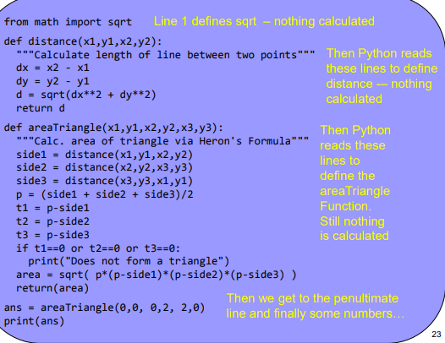
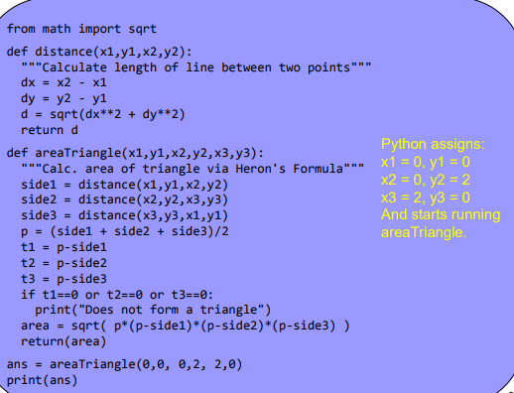

Slide 29
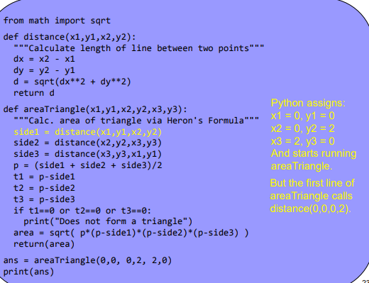
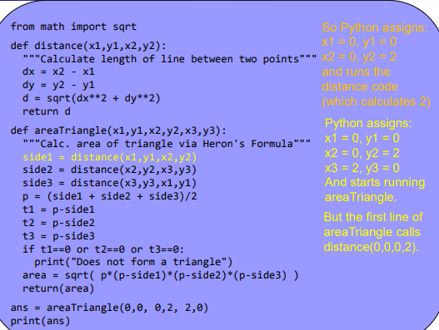

Slide 30
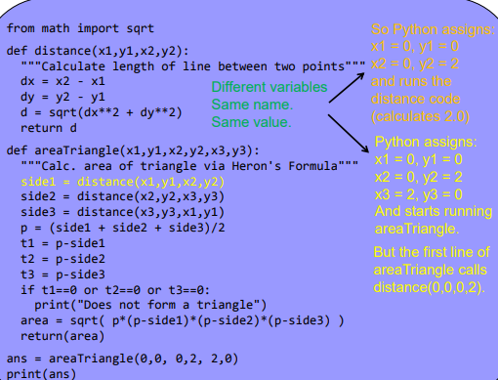
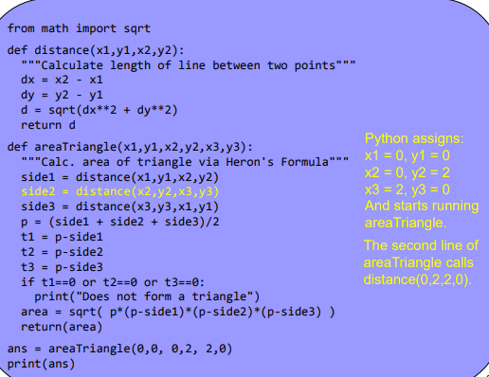

Slide 31
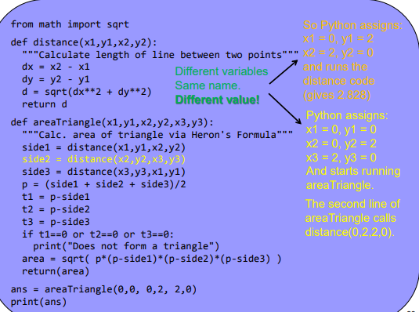
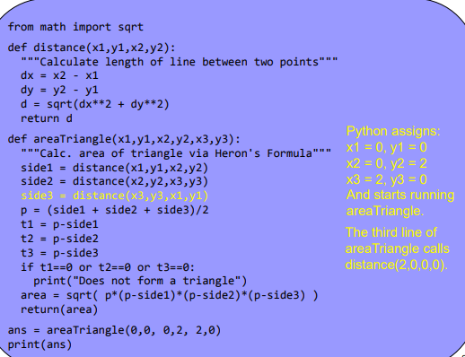

Slide 32
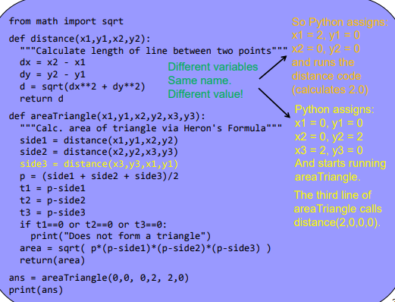
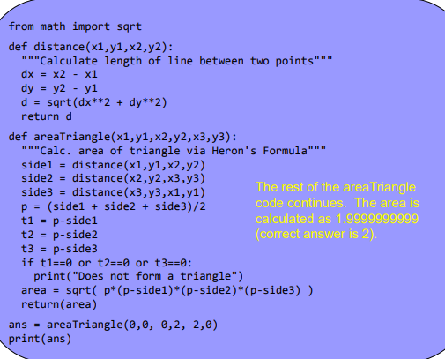

Slide 33
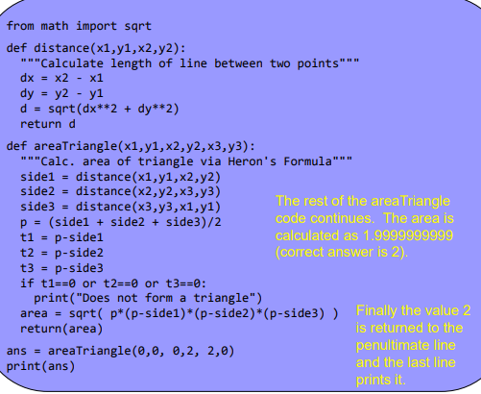
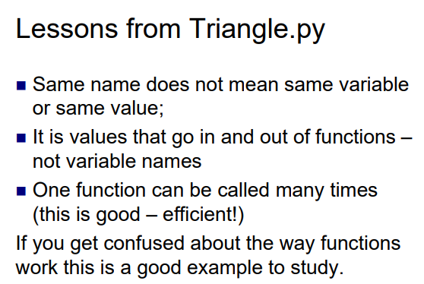

Slide 34
